Slide 1
CS326 Parallel and Distributed Computing
Fall 2021
National University of Computer and Emerging Sciences

Slide 2
Chapter 6. Programming Using the Message Passing Paradigm

Slide 3
Collective Communication and Computation Operations : Barrier
The barrier synchronization operation is performed in MPI using the MPI_Barrier function.
int MPI_Barrier(MPI_Comm comm)
The only argument of MPI_Barrier is the communicator that defines the group of processes that are synchronized.
The name of the function is quite descriptive - the function forms a barrier, and no processes in the communicator can pass the barrier until all of them call the function.

Slide 4
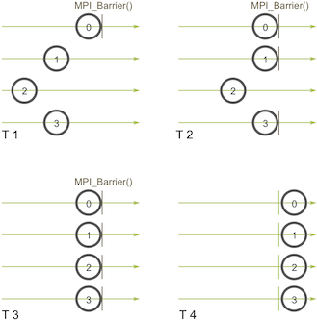

Slide 5
One-to-All Broadcast
Parallel algorithms often require a single process to send identical data to all other processes or to a subset of them. This operation is known as one-to-all broadcast.
Initially, only the source process has the data of size m that needs to be broadcast.
At the termination of the procedure, there are p copies of the initial data – one belonging to each process.
One of the main uses of broadcasting is to send out user input to a parallel program, or send out configuration parameters to all processes.

Slide 6
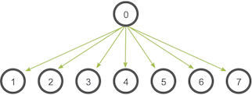

Slide 7
One-to-All Broadcast
The one-to-all broadcast operation is performed in MPI using the MPI_Bcast function
int MPI_Bcast(void *buf, int count, MPI_Datatype datatype, int source, MPI_Comm comm)
MPI_BCAST operation sends data from one member of one group to all members of the other group
MPI_Bcast sends the data stored in the buffer buf of process source to all the other processes in the group

Slide 8
One-to-All Broadcast
The data received by each process is stored in the buffer buf.
The data that is broadcast consist of count entries of type datatype .
The amount of data sent by the source process must be equal to the amount of data that is being received by each process; i.e., the count and datatype fields must match on all processes.

Slide 9
All-to-all broadcast is a generalization of one-to-all broadcast in which all p nodes simultaneously initiate a broadcast.
A process sends the same m-word message to every other process, but different processes may broadcast different messages.

Slide 10
All-to-One Reduction
In an all-to-one reduction operation, each of the p participating processes starts with a buffer M containing m words.
The data from all processes are combined through an associative operator and accumulated at a single destination process into one buffer of size m .
Reduction can be used to find the sum, product, maximum, or minimum of sets of numbers.

Slide 11
All-to-One Reduction
The all-to-one reduction operations is performed in MPI using the MPI_Reduce function.
int MPI_Reduce(void *sendbuf, void *recvbuf, int count, MPI_Datatype datatype, MPI_Op op, int target, MPI_Comm comm)
MPI_Reduce combines the elements stored in the buffer sendbuf of each process in the group, using the operation specified in op , and returns the combined values in the buffer recvbuf of the process with rank target

Slide 12
All-to-One Reduction
Both the sendbuf and recvbuf must have the same number of count items of type datatype .
Note that all processes must provide a recvbuf array, even if they are not the target of the reduction operation.
When count is more than one, then the combine operation is applied element-wise on each entry of the sequence.
All the processes must call MPI_Reduce with the same value for count , datatype , op , target , and comm .

Slide 13
All-to-All Reduction
When the result of the reduction operation is needed by all the processes, MPI provides the MPI_Allreduce operation that returns the result to all the processes.
int MPI_Allreduce(void *sendbuf, void *recvbuf, int count, MPI_Datatype datatype, MPI_Op op, MPI_Comm comm)
Note that there is no target argument since all processes receive the result of the operation.

Slide 14
MPI_Op enumeration
MPI provides a list of predefined operations that can be used to combine the elements stored in sendbuf .
For example, in order to compute the maximum of the elements stored in sendbuf , the MPI_MAX value must be used for the op argument.
MPI_MAX, MPI_MIN, MPI_SUM, MPI_PROD, MPI_LAND, MPI_BAND, , MPI_LOR, , MPI_BOR, MPI_LXOR, MPI_BXOR, MPI_MAXLOC, MPI_MINLOC

Slide 15
Prefix Sum
Finding prefix sums (also known as the scan operation) is another important problem that can be solved by using a communication pattern similar to that used in all-to-all broadcast and all-reduce operations.
Given p numbers n0, n1, ..., np-1 (one on each node), the problem is to compute the sums for all k between 0 and p - 1.
For example, if the original sequence of numbers is <3, 1, 4, 0, 2>, then the sequence of prefix sums is <3, 4, 8, 8, 10>.

Slide 16
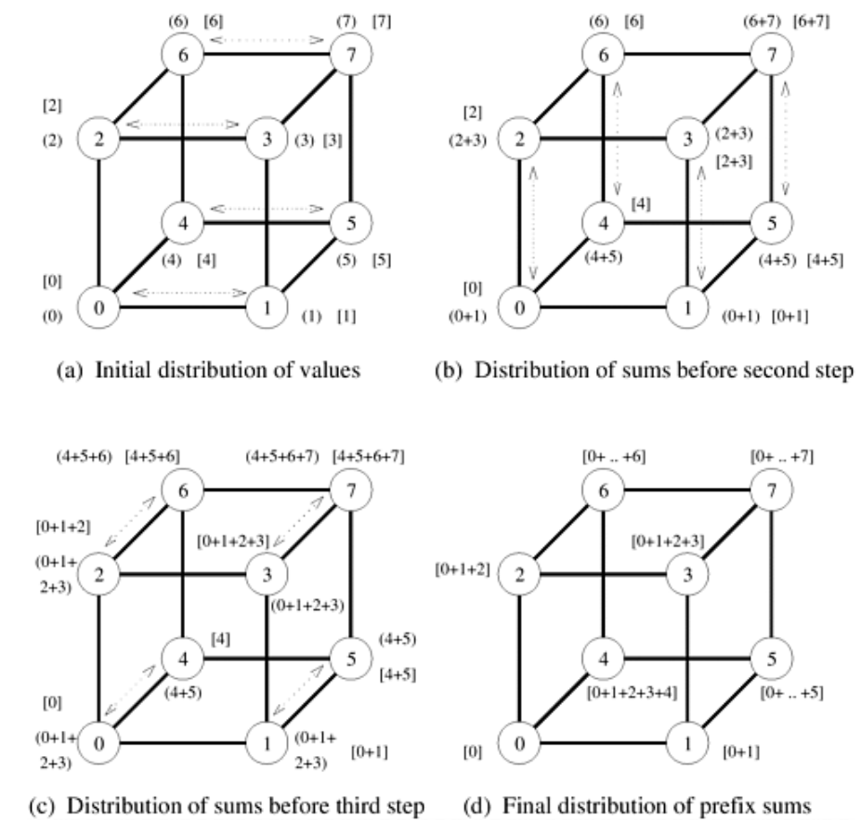

Slide 17
Prefix-Sum
The prefix-sum operation is performed in MPI using the MPI_Scan function.
int MPI_Scan(void *sendbuf, void *recvbuf, int count, MPI_Datatype datatype, MPI_Op op, MPI_Comm comm)
MPI_Scan performs a prefix reduction of the data stored in the sendbuf at each process and returns the result in the buffer recvbuf .

Slide 18
Prefix-Sum
MPI_Scan performs a prefix reduction of the data stored in the buffer sendbuf at each process and returns the result in the buffer recvbuf.
The type of supported operations (i.e., op ) as well as the restrictions on the various arguments of MPI_Scan are the same as those for the reduction operation MPI_Reduce.

Slide 19
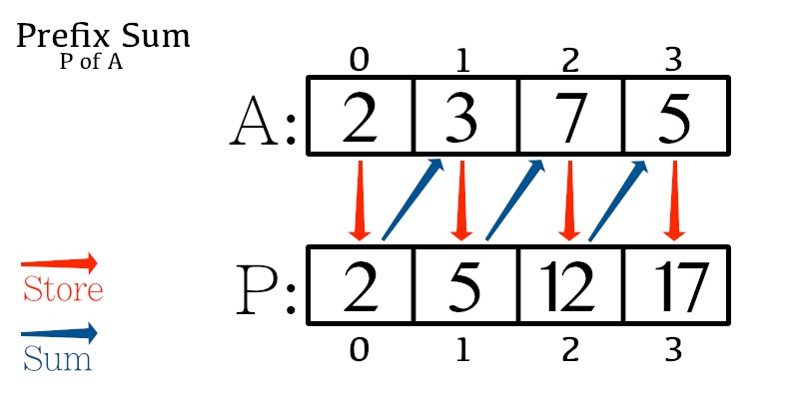

Slide 20
Scatter and Gather
In the scatter operation, a single node sends a unique message of size m to every other node.
This operation is also known as one-to-all personalized communication.
One-to-all personalized communication is different from one-to-all broadcast in that the source node starts with p unique messages, one destined for each node.
Unlike one-to-all broadcast, one-to-all personalized communication does not involve any duplication of data.

Slide 21
Scatter and Gather
The dual of one-to-all personalized communication or the scatter operation is the gather operation, or concatenation, in which a single node collects a unique message from each node.
A gather operation is different from an all-to-one reduce operation in that it does not involve any combination or reduction of data.

Slide 22
Scatter
The scatter operation is performed in MPI using the MPI_Scatter function.
int MPI_Scatter(void *sendbuf, int sendcount, MPI_Datatype senddatatype, void *recvbuf, int recvcount, MPI_Datatype recvdatatype, int source, MPI_Comm comm)
The source process sends a different part of the send buffer sendbuf to each processes, including itself.

Slide 23
Scatter
The data that are received are stored in recvbuf .
Process i receives sendcount contiguous elements of type senddatatype starting from the i.
MPI_Scatter must be called by all the processes with the same values for the sendcount, senddatatype, recvcount , recvdatatype , source , and comm arguments.
Note again that sendcount is the number of elements sent to each individual process.

Slide 24
Gather
The gather operation is performed in MPI using the MPI_Gather function.
int MPI_Gather(void *sendbuf, int sendcount, MPI_Datatype senddatatype, void *recvbuf, int recvcount, MPI_Datatype recvdatatype, int target, MPI_Comm comm)
Each process, including the target process, sends the data stored in the array sendbuf to the target process.
As a result, if p is the number of processors in the comm , the target process receives a total of p buffers.

Slide 25
Gather
The data is stored in the array recvbuf of the target process, in a rank order.
The data sent by each process must be of the same size and type.
That is, MPI_Gather must be called with the sendcount and senddatatype arguments having the same values at each process.

Slide 26
MPI also provides the MPI_Allgather function in which the data are gathered to all the processes and not only at the target process.
int MPI_Allgather(void *sendbuf, int sendcount, MPI_Datatype senddatatype, void *recvbuf, int recvcount, MPI_Datatype recvdatatype, MPI_Comm comm)
The meanings of the various parameters are similar to those for MPI_Gather ; however, each process must now supply a recvbuf array that will store the gathered data.

Slide 27
All-to-All Personalized Communication
In all-to-all personalized communication, each node (process) sends a distinct message of size m to every other node.
Each node sends different messages to different nodes, unlike all-to-all broadcast, in which each node sends the same message to all other nodes.
All-to-all personalized communication is also known as total exchange.
This operation is used in a variety of parallel algorithms such as fast Fourier transform, matrix transpose, sample sort, and some parallel database join operations.

Slide 28
The all-to-all personalized communication operation is performed in MPI by using the MPI_Alltoall function.
int MPI_Alltoall(void *sendbuf, int sendcount, MPI_Datatype senddatatype, void *recvbuf, int recvcount, MPI_Datatype recvdatatype, MPI_Comm comm)
Each process sends a different portion of the sendbuf array to each other process, including itself.

Slide 29
Task
For every group communication function, explain two algorithms/problems/systems which utilize them.

Slide 30
Overlapping Communication with Computation
The MPI programs we developed so far used blocking send and receive operations whenever they needed to perform point-to-point communication.
Recall that a blocking send operation remains blocked until the message has been copied out of the send buffer.
Similarly, a blocking receive operation returns only after the message has been received and copied into the receive buffer.

Slide 31
Non-Blocking Communication Operations
In order to overlap communication with computation, MPI provides a pair of functions for performing non-blocking send and receive operations.
These functions are MPI_Isend and MPI_Irecv.
MPI_Isend starts a send operation but does not complete, that is, it returns before the data is copied out of the buffer.
Similarly, MPI_Irecv starts a receive operation but returns before the data has been received and copied into the buffer.

Slide 32
However, at a later point in the program, a process that has started a non-blocking send or receive operation must make sure that this operation has completed before it proceeds with it computations.
This is because a process that has started a non-blocking send operation may want to overwrite the buffer that stores the data that are being sent, or a process that has started a non-blocking receive operation may want to use the data it requested.

Slide 33
To check the completion of non-blocking send and receive operations, MPI provides a pair of functions MPI_Test and MPI_Wait.
MPI_Test tests whether or not a non-blocking operation has finished.
MPI_Wait waits (i.e., gets blocked) until a non-blocking operation actually finishes.

Slide 34
The calling sequence of MPI_Isend is:
int MPI_Isend(void *buf, int count, MPI_Datatype datatype, int dest, int tag, MPI_Comm comm, MPI_Request *request)
The calling sequence of MPI_Irecv is:
int MPI_Irecv(void *buf, int count, MPI_Datatype datatype, int source, int tag, MPI_Comm comm, MPI_Request *request)

Slide 35
Note that these functions have similar arguments as the blocking send and receive functions. The main difference is that they take an additional argument request.
MPI_Isend and MPI_Irecv functions allocate a request object and return a pointer to it in the request variable.
This request object is used as an argument in the MPI_Test and MPI_Wait functions to identify the operation whose status we want to query or to wait for its completion.
Note that the MPI_Irecv function does not take a status argument similar to the blocking receive function, but the status information associated with the receive operation is returned by the MPI_Test and MPI_Wait functions.

Slide 36
int MPI_Test(MPI_Request *request, int *flag, MPI_Status *status)
int MPI_Wait(MPI_Request *request, MPI_Status *status)
MPI_Test tests whether or not the non-blocking send or receive operation identified by its request has finished. It returns flag = {true} (non-zero value in C) if it completed, otherwise it returns {false} (a zero value in C).
In the case that the non-blocking operation has finished, the request object pointed to by request is de-allocated and request is set to MPI_REQUEST_NULL. Also the status object is set to contain information about the operation.

Slide 37
The MPI_Wait function blocks until the non-blocking operation identified by request completes.
In that case it de-allocates the request object, sets it to MPI_REQUEST_NULL, and returns information about the completed operation in the status object.

